Slide 1
Data (Images, Sound, Text) as Vectors

Slide 2

Data are modelled as vectors over the real space $ℝ$
Remember: A vector $x∈ ℝ^{n}$ is a sequence of $n$real numbers

Slide 3
Data are vectors, results become numbers
Vektor
Number
(marketing expenses / month)
revenue / month
(2700)
140000
(age, gender, #lecture attendance )
exam grade
(19, 1, 17 )
1.7
Female = 1,
Male = 0,

Slide 4
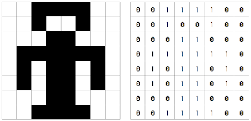
Images are vectors
Image by Josef Steppan - Own work, CC BY-SA 4.0, https://commons.wikimedia.org/w/index.php?curid=64810040

Slide 5

Gray Value Images
Image by Josef Steppan - Own work, CC BY-SA 4.0, https://commons.wikimedia.org/w/index.php?curid=64810040

